Slide 1
Twitter API Set up
How to set up you developer account and get the API Keys
– Version 3

Slide 2
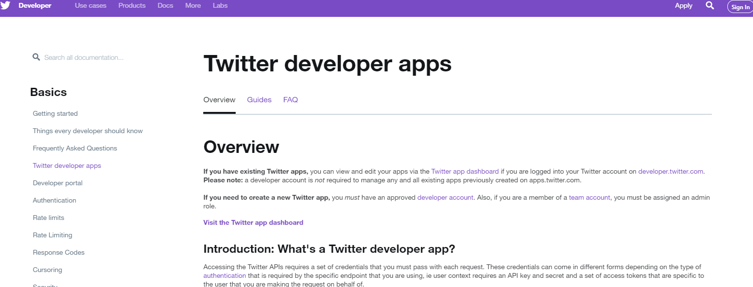
Go to twitter developer apps
https://developer.twitter.com/en/docs/basics/apps/overview.html
Click Apply

Slide 3
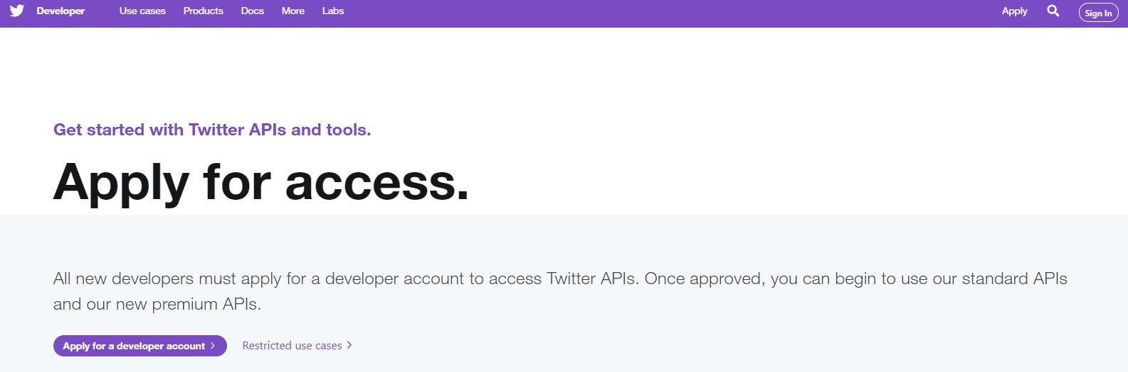
Apply for developer account
Click Apply

Slide 4
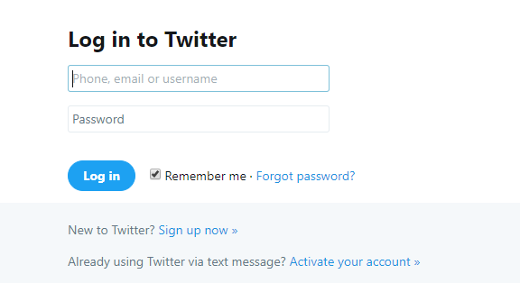
Fill in your developer account or sign up new account
For those with Twitter Account, please log in
For those who do not have Twitter Account, please sign up now

Slide 5
Signing up new twitter account

Slide 6
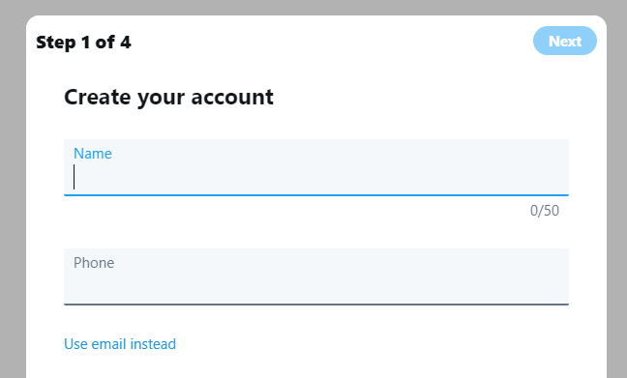
#1 Key in Name, Phone / Email and hit “sign up” button when done
Fill in Name, Phone or Email
(FYI, better to use Email, but only if you have a laptop)

Slide 7
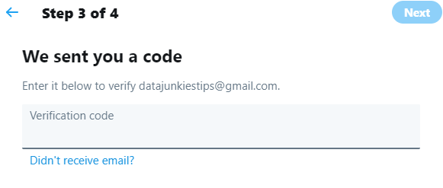
#2 Key in the Verification Code that was sent
Fill in the verification code

Slide 8
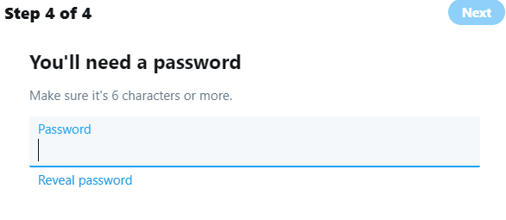
#3 Fill in a password
Fill in the password
You can skip the profile picture, bios, interests
Go ahead and click a few people to follow

Slide 9
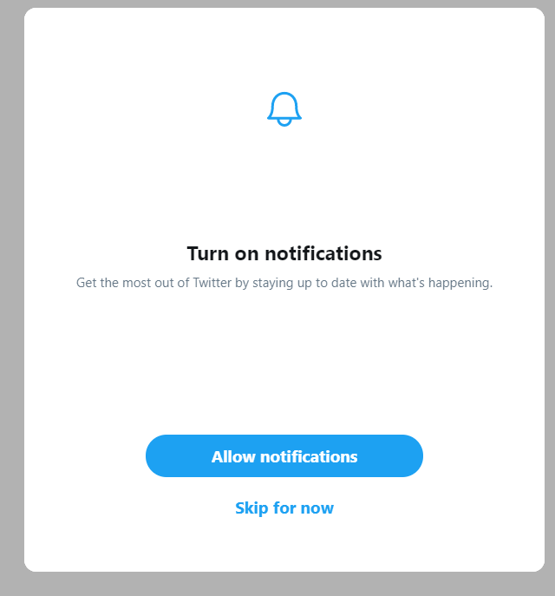
#4 You can turn on notifications, or skip it

Slide 10
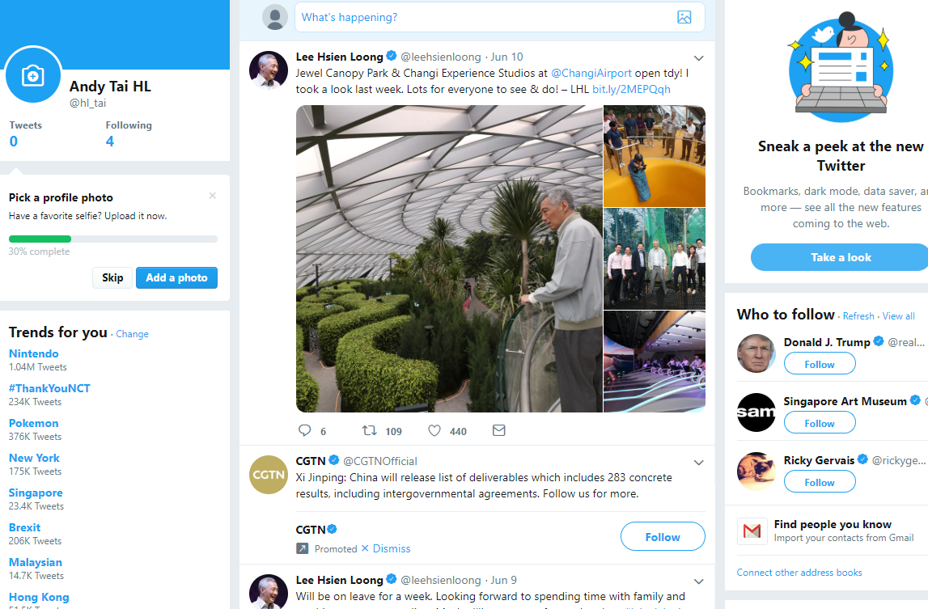
… and your twitter account is ready

Slide 11
Log in to your twitter account to complete developer account set up

Slide 12
Con’t to set up twitter developer account…
Please log in now…

Slide 13
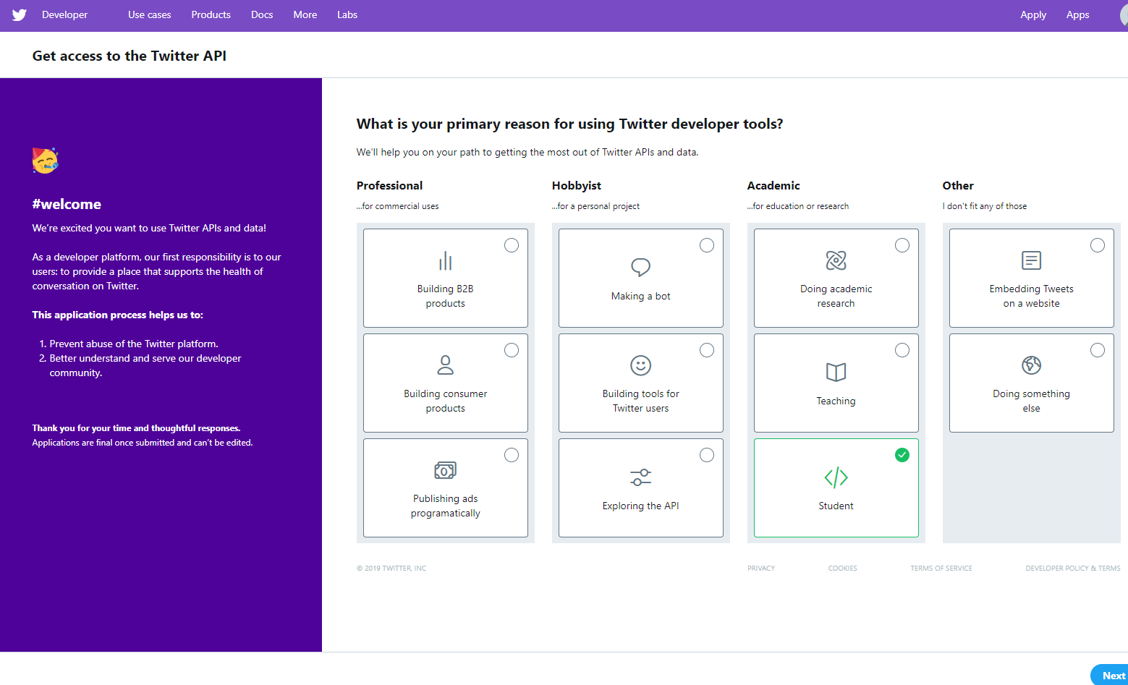
Select “Student” as primary reason
Click Next

Slide 14
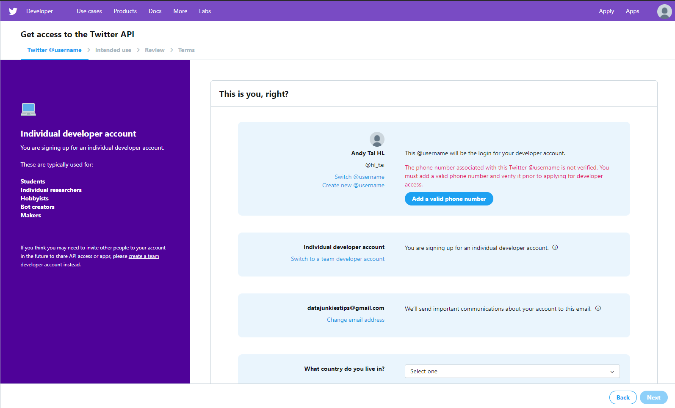
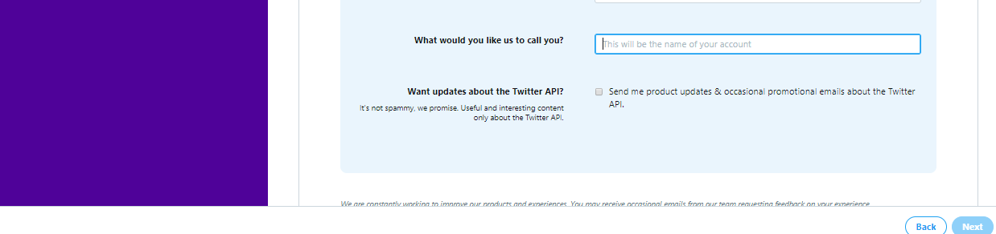
Fill in the required fields
Add valid Singapore hp number, and click follow-on authentication procedures
Select “Singapore”
Select simple name
Click Next

Slide 15
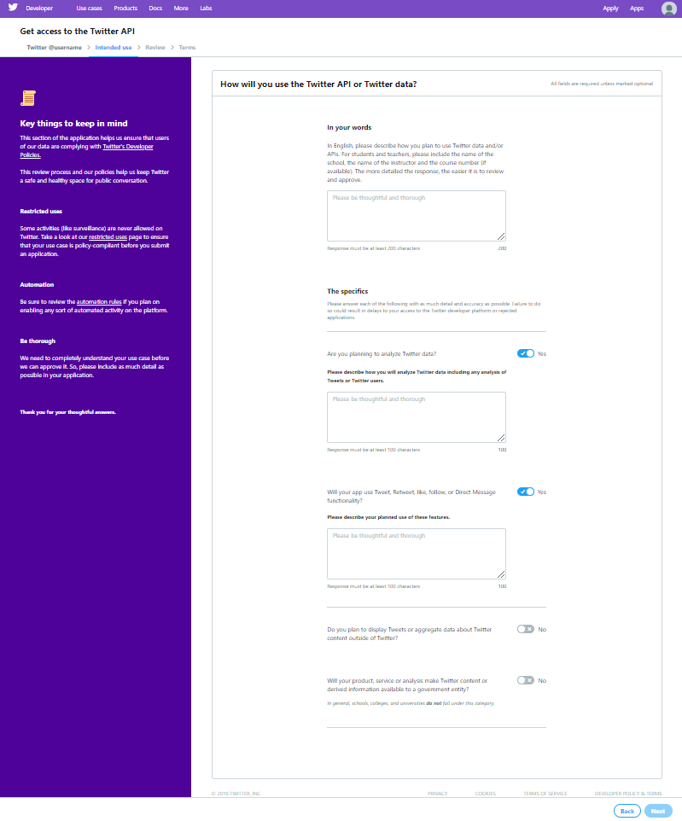
Copy and paste the text into the fields
Copy and paste the respective paragraphs to the fields.
Select “No” for the last 2 options
Click Next

Slide 16
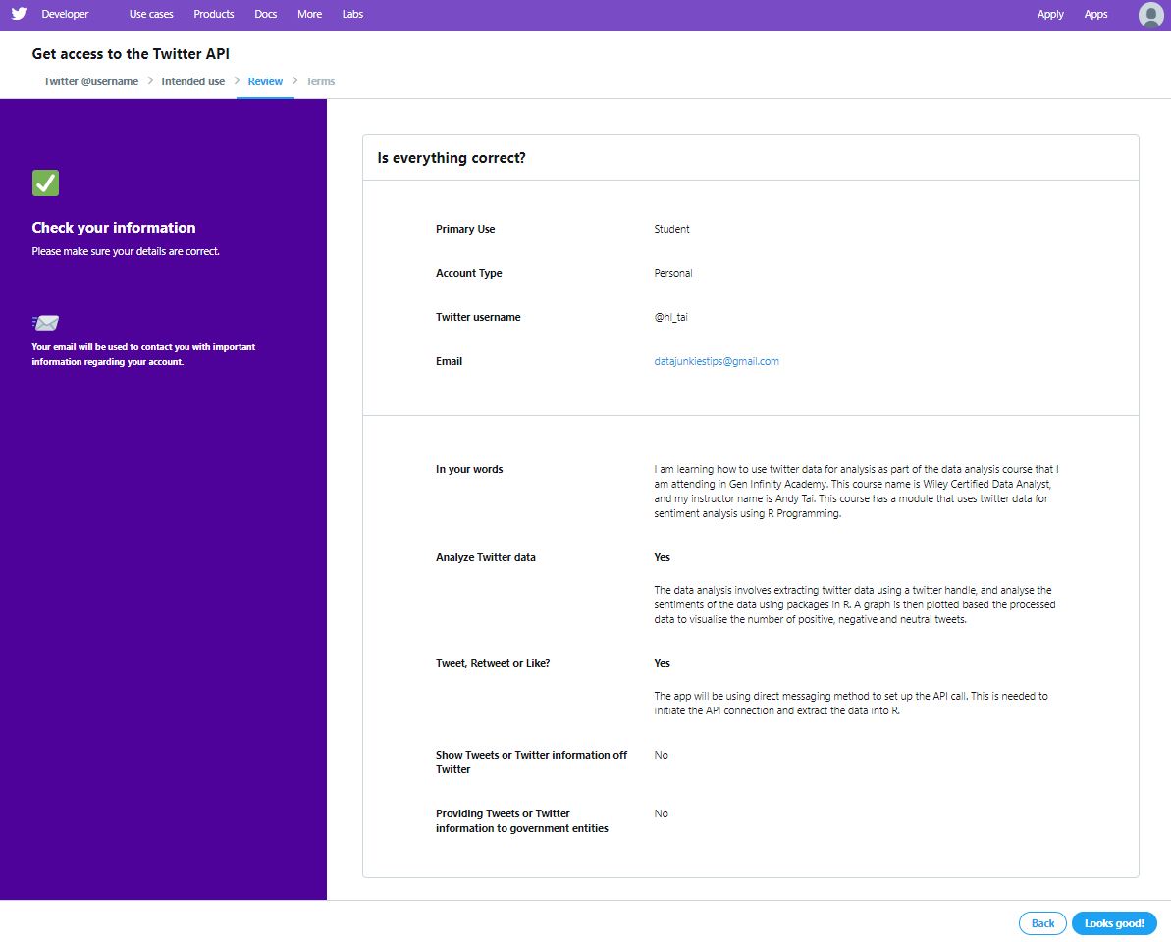
Check, and click “Looks good!”
Click Next

Slide 17
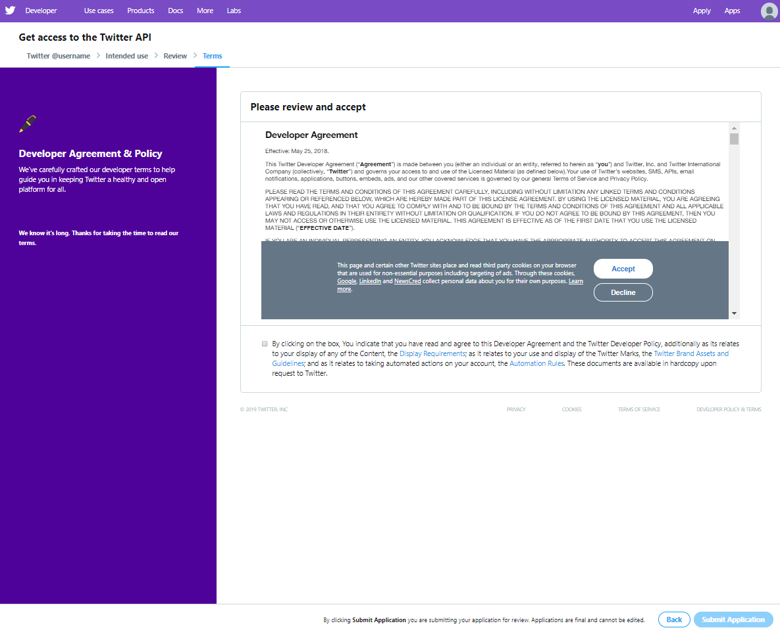
Read and if no issue, say yes to all the T&Cs
Accept the T&Cs
Tick the check box
Click Submit Application

Slide 18
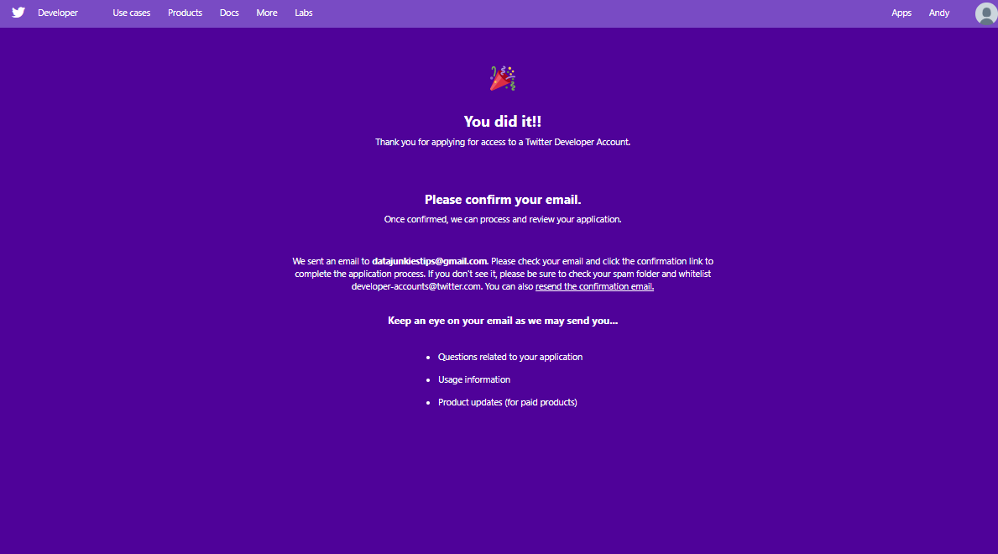
You did it!
Confirm your email using laptop…
Do Not use handphone to access your email to confirm

Slide 19
Create your twitter API keys

Slide 20
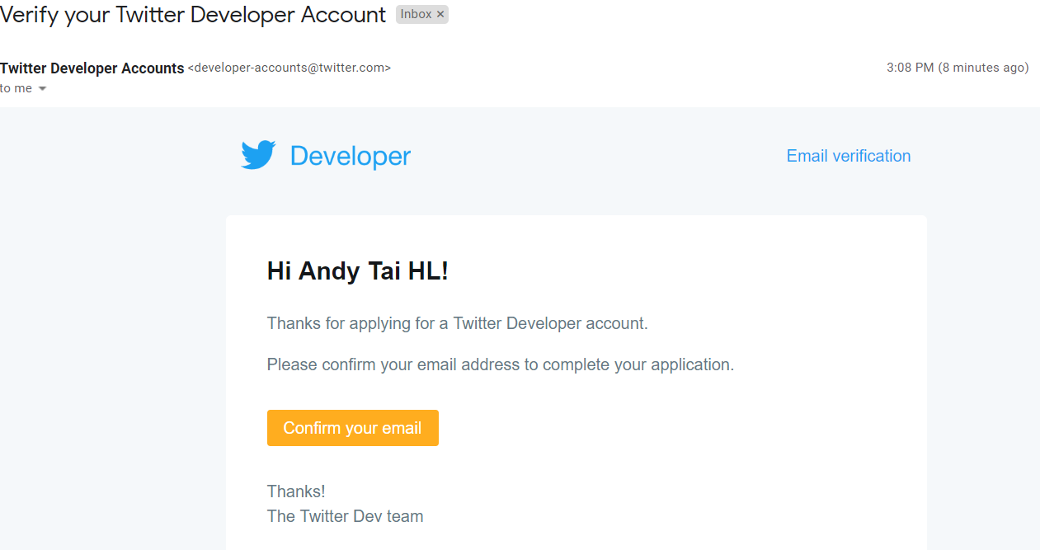

Confirm your email using laptop
Confirm your email using laptop…
Do Not use handphone to access your email to confirm

Slide 21
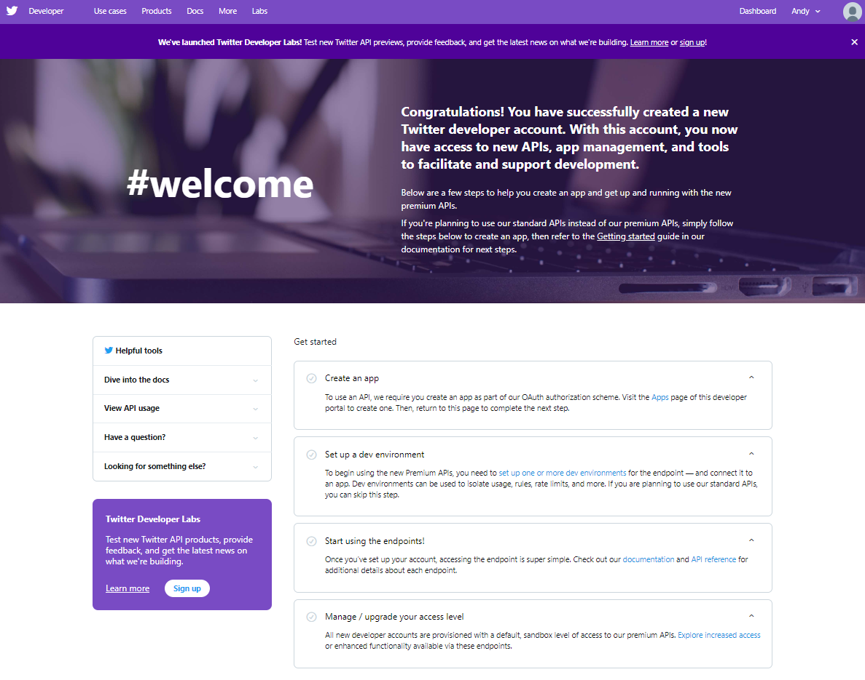
Select “create and app”
Click “create and app”

Slide 22
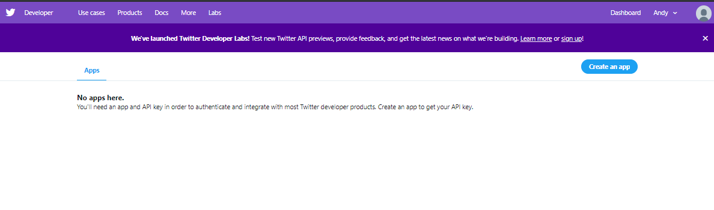
Again click “create an app”
Click “create and app”

Slide 23
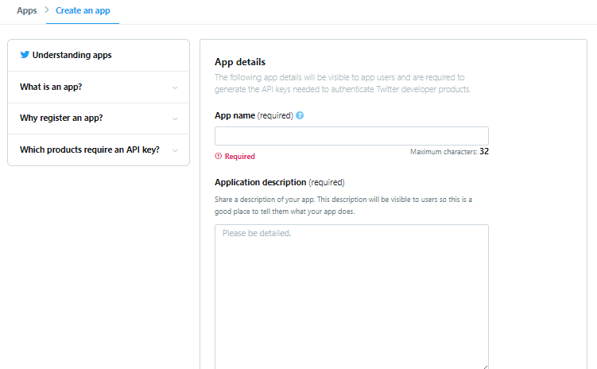
Fill in fields #1
Put a suitable app name
e.g. Tai_tweet_analysis_1
Copy and paste appropriate sentence in this field

Slide 24
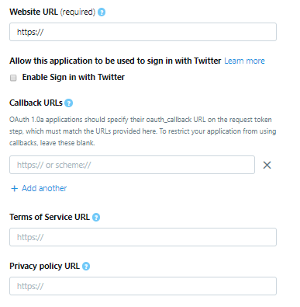
Fill in fields #2
Put in a suitable URL
e.g. https://trendwiseanalytics.com
Tick checkbox
Put in a suitable URL
e.g. https://trendwiseanalytics.com
e.g. https://127.0.0.1:1410
Leave empty

Slide 25
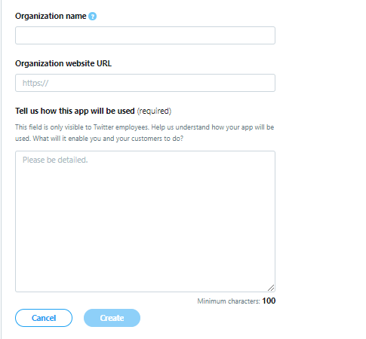
Fill in fields #3
Copy and paste appropriate sentence in this field
Click “Create”

Slide 26
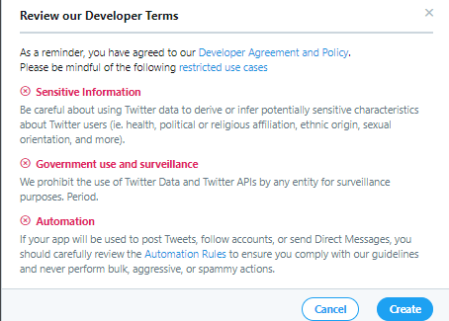
Fill in fields #4
Click “Create”

Slide 27
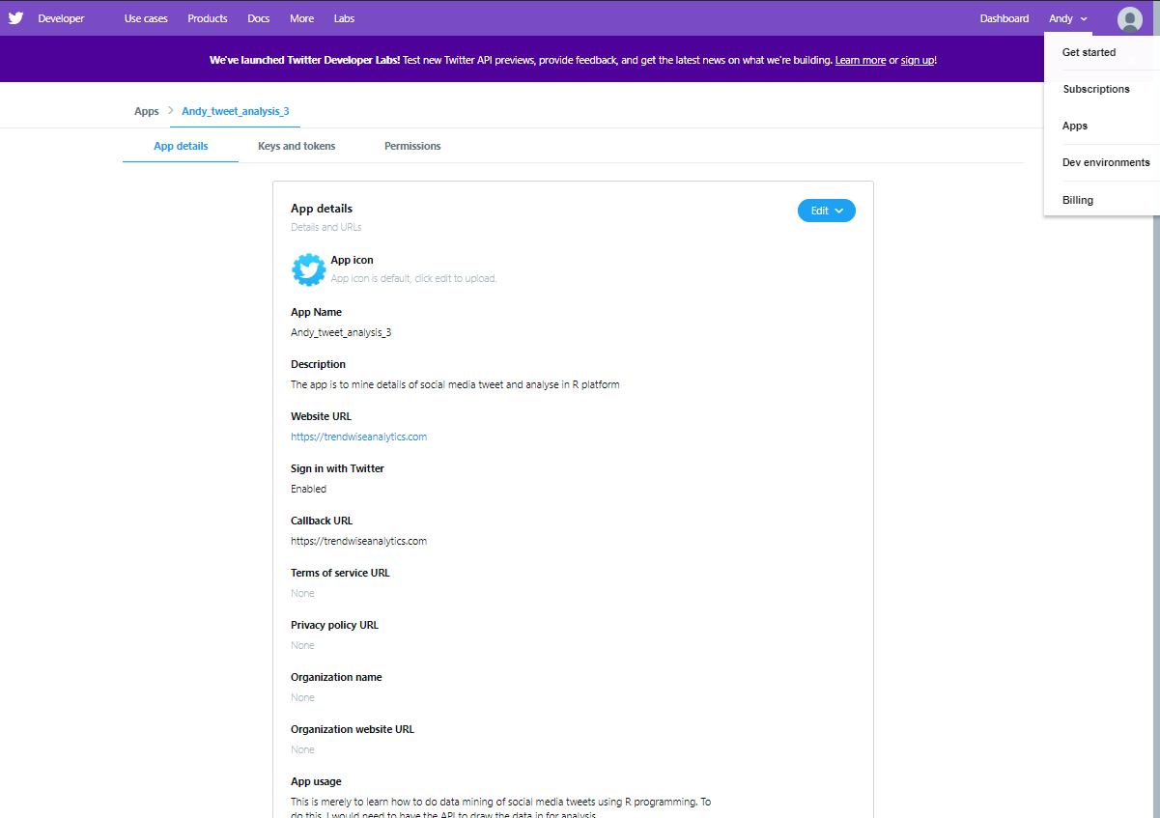
Click “keys and tokens” tab

Slide 28
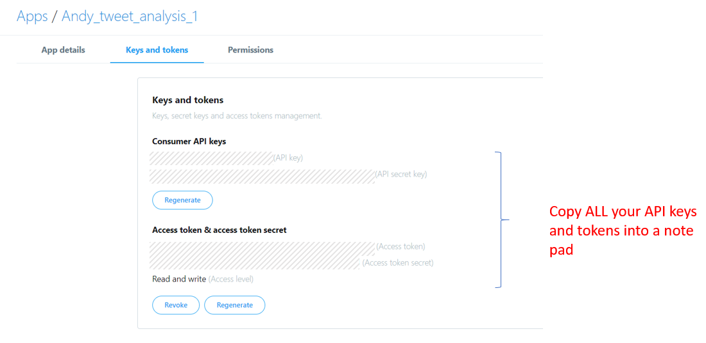
Generate and copy all your keys and paste in note pad

Slide 29
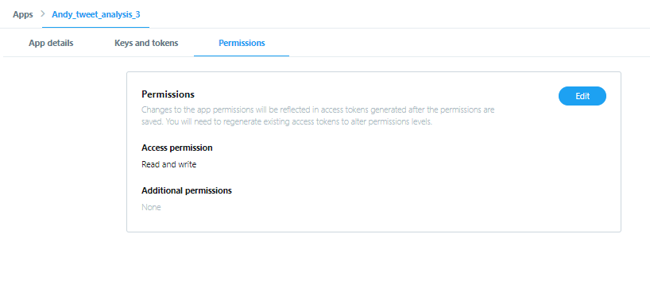
Click “Permissions” tab
Click “Edit”

Slide 30
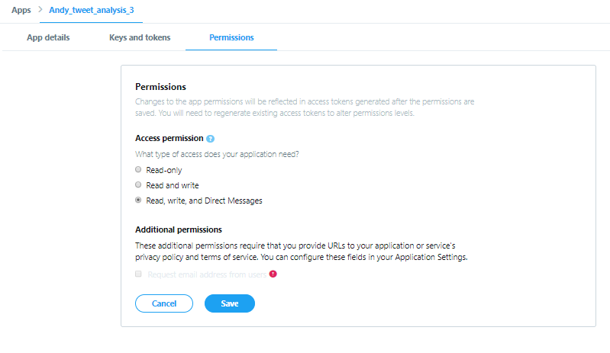
Select “Read, write, and Direct Messages”
Select this
Click “Save”

Slide 31
Yeah! You are all good! We can now do programming in our R script! Let’s Go!

